Slide 1

Convolutional Neural Networks
Advanced Analytics - Mazars Labs
November 22th 2019
Westley Birmingham, Data Scientist – Group Innovation Team

Slide 2
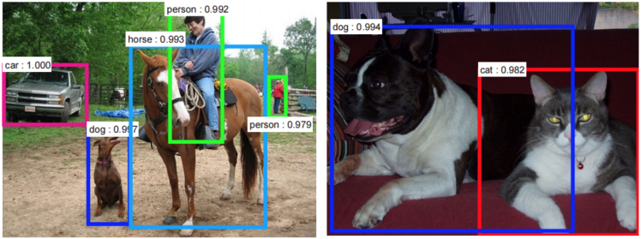
Introduction

Slide 3
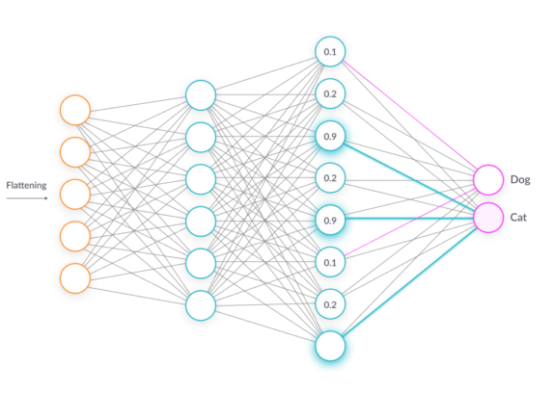

Artificial Neural Networks
Quick recall
Step 1: Forward Propagation
Input
Layer 1
Layer 2
Output
Step 2: Back Propagation and Weight Updation

Slide 4

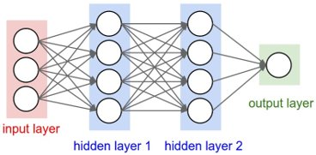
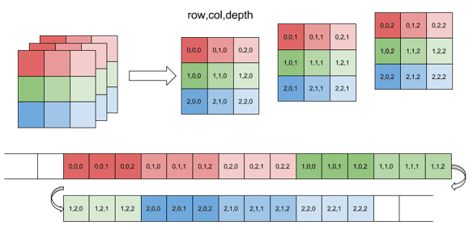
Intuition and basic architecture
Working with images
width: 1500 px
height: 1500 px
1500 x 1500 x 3 = 6,750,000 Inputs features
Full connectivity is costly​
Number of parameters = Overfitting​
Translational invariance​

Slide 5

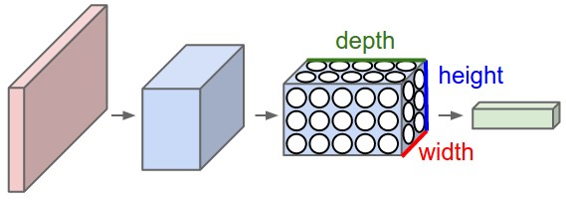
Intuition and basic architecture
Convolutional Neural Networks, ConvNets or CNN
Convolutional Neural Network: Three-dimensional layers, width and height are the dimensions of the image, and the depth would be 3 (RGB Channels)
Regular Neural Network:
Fully connected layers

Slide 6
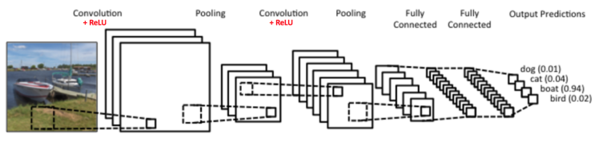
The CNN Architecture
CNNs typically have two parts
Hidden layers/features extraction part series of convolutions and pooling.
Classification part fully-connected layers for predicting the class.
Features extraction
Classification

Slide 7
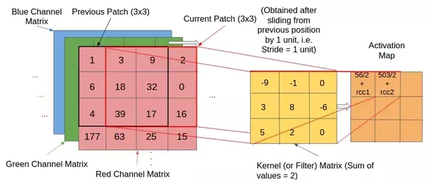

Convolution layers
How Applying a function called “convolution” using a filter (or a kernel) to two different dimensions: the width and the height of the image and the produced output is called a feature map.
The animation below shows the convolution operation.
The filter (orange square) is sliding over our input (the green square)
The sum of the convolution goes into the feature map (the red square)

Slide 8
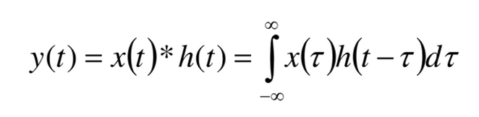
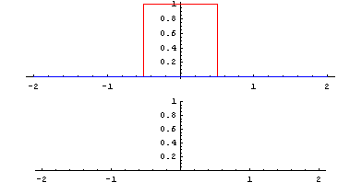
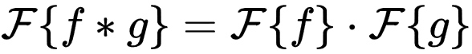
Definition of the operation “convolution”
The convolution is a mathematical operation, like the addition or the multiplication, that takes as input two functions and returns a 3rd one :
The identity function of the convolution is a Dirac function.
It has many applications in signal processing, especially in image processing. The Fourier transform of a convolution of two functions is the multiplication of the two functions’ Fourier transforms:
https://www.youtube.com/watch?v=HW4IamyQnzw

Slide 9
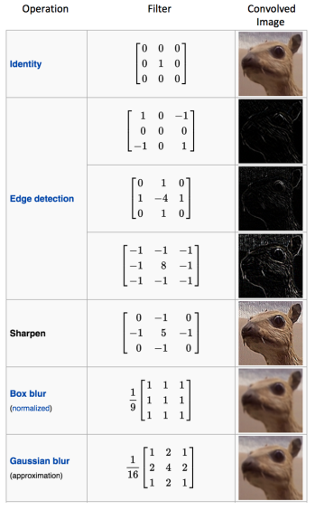

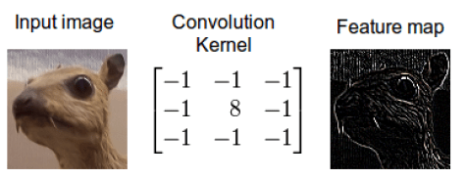

Convolution FILTERS
Focus on filters

Slide 10

Convolution layers
The size of the convolved feature is controlled by three parameters:
Depth: Depth is the number of filters used for the convolution operation.
Stride: Stride is the number of pixels we slide our filter over the input matrix. When the stride is 1, the filter moves one pixel at a time. Larger strides will produce smaller feature maps.
How do we prevent our feature map from shrinking ?
Padding: Adding a zero-value layer to surround the input with zeros: we ensure keeping the spatial size constant, improve performance and make sure the kernel/stride size fit the input.

Slide 11
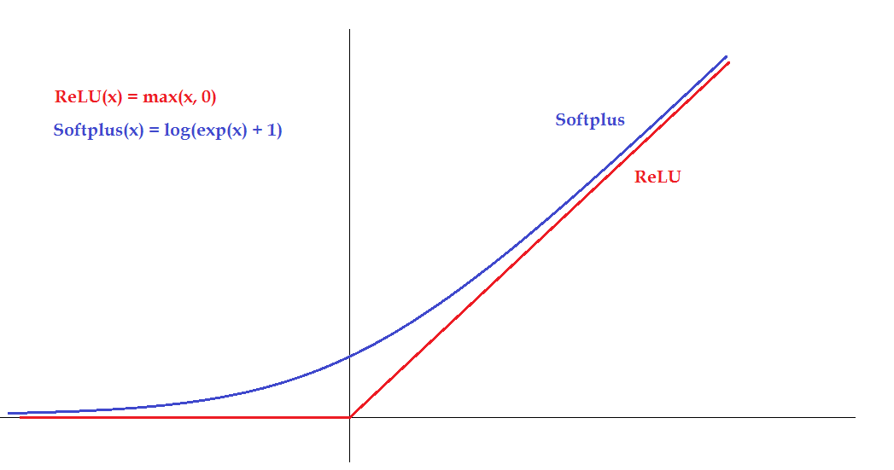

Introducing non-linearity
Purpose Make the output non-linear, thus using an activation function like ReLu (Rectified Linear Unit)
How:
Since convolution is a linear operation, we account for non-linearity by introducing a non-linear function like ReLu

Slide 12
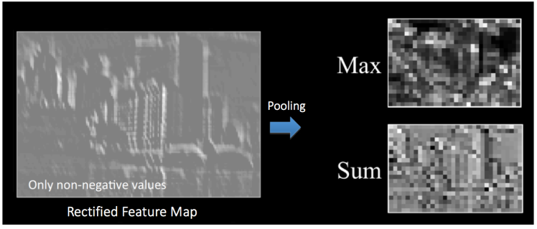
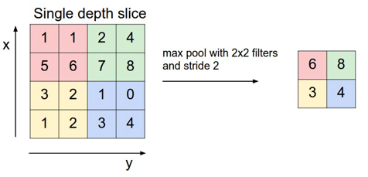
Pooling layers
Purpose
Continuously reduce the dimensionality to reduce the number of parameters and computation in the network. This shortens the training time, prevents overfitting and makes the network invariant to small transformations. Spatial Pooling can be of different types: Max, Average, Sum etc.
How
In case of max pooling layers, we define a spatial neighbourhood (for example, a 2x2 window) and take the max. element within the window. Then we slide the window, this is called stride.

Slide 13
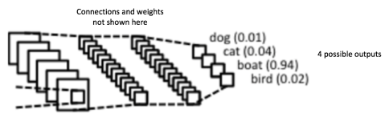
Fully-connected layers
Purpose
To use the mapped features for classifying the input image into various classes based on the training dataset.

Slide 14
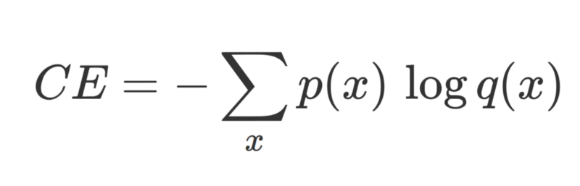
Combining all the layers
The overall training process can be summarized as below
Step 1 - Initialize all filters/parameters/weights
Step 2 - Take an image as input, go through the forward propagation step (Conv + Activation + Pooling + FC) and output probabilities for each class.
Step 3 - Calculate the Cross-Entropy CE at the output layer:
Step 4 - Use backpropagation to calculate the gradients of the error and use gradient descent to update all filter/weights values.
Step 5 - Repeat steps 2-4 with all the images in the training set.
Step 2
Step 4
Step 3

Slide 15
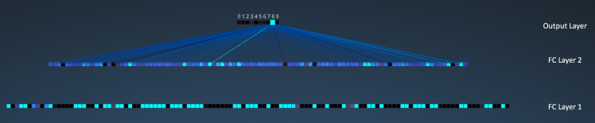
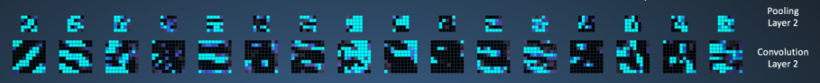
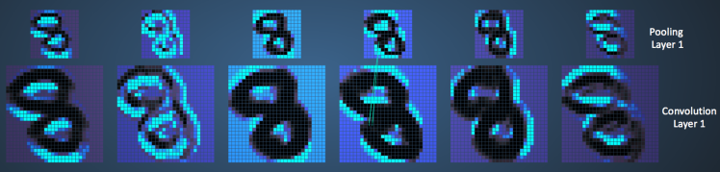

Visualizing Convolutional Neural Networks
Classification
Feature Extraction

Slide 16
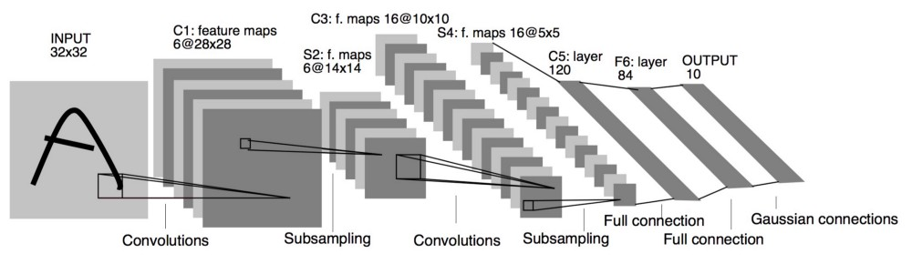
Common CNN architectures
There are several known architectures in the field of Convolutional Networks
LeNet: the first successful application of CNNs, developed by Yann LeCun in the 90’s. It was used to read zip codes, digits, etc.

Slide 17

Common CNN architectures
There are several known architectures in the field of Convolutional Networks
AlexNet: the first work that popularized Conv. Networks in Computer Vision. Won the ImageNet Large Scale Visual Recognition Challenge (ILSVRC) Challenge in 2012 where it outperformed the runner-up (16% error compared to 26% error)

Slide 18
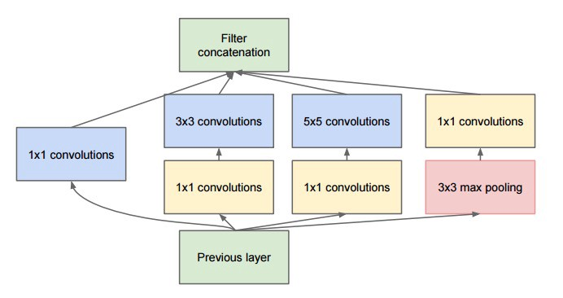
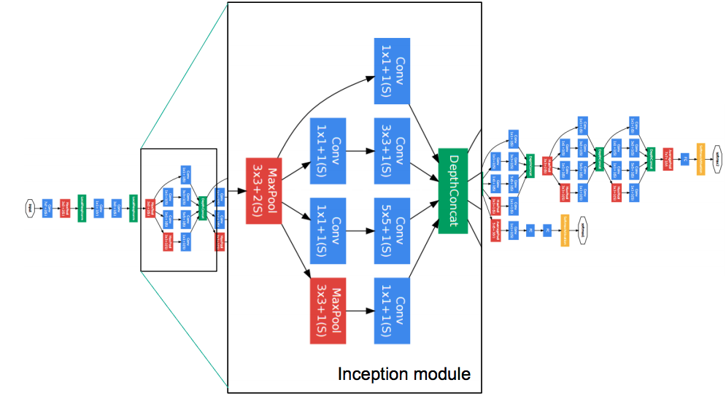
Common CNN architectures
There are several known architectures in the field of Convolutional Networks
GoogLeNet: ILSVRC 2014 winner. The ancestor of Inception-v4. The main contribution was developing an Inception Module that reduced the number of parameters in the network (4M compared to 60M in AlexNet).

Slide 19
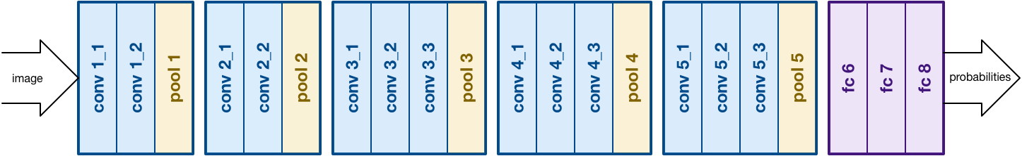
Common CNN architectures
There are several known architectures in the field of Convolutional Networks
VGGNet: its main contribution was showing that the depth of the network is a critical component for good performance.

Slide 20
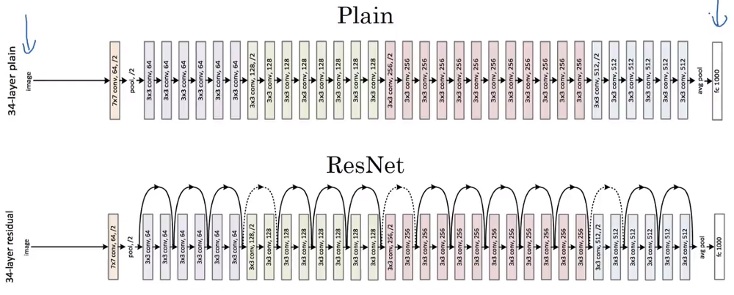
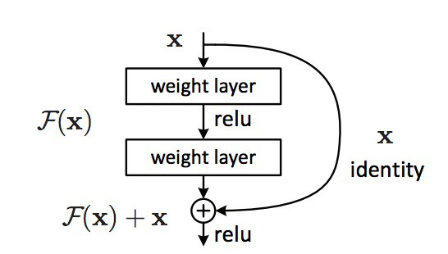
Common CNN architectures
There are several known architectures in the field of Convolutional Networks
ResNet: the revolutionary principle is to feed the output of two successive layers and bypass the input to the next layers. This architecture uses heavily batch normalization.

